Slide 1

3-Year Financial & Business Rescue Plan
Advanced Corporate Finance | NYSE: AMC
A presentation by Matthew Olivo

Slide 2
Reading the Financials: The Problem Is Below the Operating Line
🍿 Key Insight: AMC had positive operating income in both 2023 ($39M) and 2024 ($37M) — and 2025 is tracking ~$112M per CEO guidance. The business actually works. Net losses come entirely from $530M/year in interest expense — a balance sheet problem, not a revenue or cost problem.
$4.85B
$4.1B
$530M
0.07x
2024 Revenue
Long-Term Debt
Annual Interest Expense
Interest Coverage (EBIT÷Int.)
vs. $5.4B pre-COVID (2019)
COVID-era survival borrowing
~11% of revenue every year
healthy range is above 1.5x
2024 Income Statement — Where Did the Money Go?
Industry Context
Gross Profit
+$3,243
🎬 Box office hit ~$9B in 2024, recovering steadily
Less: Operating Expenses
–$3,207
🎬 AMC is the #1 theater chain in the U.S. and world
= Operating Income (EBIT)
+$37
🎬 2025 revenue tracking up ~4.6% per CEO guidance
Less: Interest Expense
–$530
← this is the problem
🎬 Operations profitable at EBIT level — trend improving
Less: Other Items
–$138
🎬 $375M of debt already paid down in 2024 — plan works
= Net Loss
($637)
Bottom line: fix the debt and AMC is profitable. Everything else flows from that.

Slide 3
Is AMC a Real Opportunity? Applying the Idea vs. Opportunity Test
Before building a 3-year plan (2026–2028), we need to test whether this is actually worth pursuing.
✓
Is there a large, durable market?
✓
Does AMC have a sustainable competitive advantage?
Yes — North American box office recovered to ~$9B in 2024 and is expected to grow toward $10B+ by 2028. Theatrical is not dying; it is shifting. Premium formats and event cinema are growing even as standard showings plateau. People still go to movies.
Yes — scale and real estate. AMC is the world's largest theater chain with ~350 U.S. locations. Its size gives it leverage with studios on film terms and with vendors on concession costs. That scale took decades to build and can't be replicated quickly.
✓
Can it reach profitability with a credible path?
!
What is the key risk?
Yes, if debt is addressed. Reduce annual interest from $530M (2025 actual) to $270M by 2028 through refinancing + debt paydown. That's enough: 2027 is the first profitable year ($102M net income), and 2028 hits $357M. No heroic revenue assumptions required.
Box office underperformance. If studios keep shifting releases to streaming, attendance could stagnate. Mitigation: the plan builds private events, premium F&B, and subscriptions specifically to reduce dependence on any single film.
🎬 Verdict: Real opportunity. 2025 EBIT was $40.5M — operations ARE profitable. Fix the debt, reduce interest from $530M to $270M by 2028, and AMC is solidly in the black.

Slide 4
Pillar 1: Fix the Capital Structure to Stop the Bleeding
The Capital Structure Problem
TVM: Why Paying Down Debt Is the Best Investment
Capital structure theory says the optimal debt-to-equity mix minimizes cost of capital. AMC's Debt/EBITDA of 7.1x (2024) is way outside that range — lenders price the debt at junk-bond rates, compounding the problem. The 2026–2028 plan brings this below 3x.
💰 The TVM math:
• Reduce debt from $4.1B → $1.8B over 2026–2028
• Saves $350M/yr in cash interest by 2028
• PV of those savings over 10 yrs at 8% discount rate ≈ $2.3B
• Every $100M paid off saves ~$7M/yr — it snowballs
Interest Coverage: The 2026–2028 Recovery Arc
(EBIT ÷ Interest Expense — need above 1.0x to be self-sustaining)
Year
EBIT ($M)
Interest ($M)
Coverage
How We Execute (2026–2028)
2024A
(7)
444
(0.02x)
🎬 Refinance near-term maturities
2025A
41
530
0.08x
Roll any remaining 2026–27 notes to longer-dated instruments. AMC already cleared its 2026 maturities — extending the runway.
🎬 Direct all free cash flow to principal
2026E
637
380
1.68x
Any FCF above $150M operating reserve → debt principal. At $400–600M annual FCF projected, this drives ~$600M/yr reduction.
▲ 1.0x threshold — plan crosses here in 2027
2027E
916
270
3.39x
🎬 Sell non-core assets
2028E
1,160
180
6.44x
Explore sale-leaseback of real estate and European theater divestiture. Redeploy proceeds to principal paydown.
🎬 No more dilutive equity raises
At <$4/share, every new share destroys value. The plan earns its way out — not prints its way out.

Slide 5
Pillars 2 & 3: Building Revenue and Cutting Costs to Fund the Recovery
Higgins Sustainable Growth Model: SGR = Net Margin × Asset Turnover × Leverage × Retention Rate. Negative net margin makes SGR negative right now. This plan restores positive margins in 2027 (Year 2) and improves asset turnover through portfolio rationalization — so growth is funded by earnings, not by issuing more dilutive stock.
🍿 Pillar 2: Grow Higher-Margin Revenue
🎞️ Pillar 3: Cut Costs That Don't Generate Cash
🎬 Premium Large Format (+50 screens)
▸ Close ~35 underperforming locations
PLF tickets earn 40–60% more per seat with almost no extra fixed cost. Directly improves gross margin AND cash flow. Target: +$180M by 2028.
Lowest-attendance venues eliminate $80M/yr in fixed lease + labor. Minimal revenue impact — these are the places people aren't going.
🍸 Premium F&B — bars and in-seat dining
▸ Renegotiate leases everywhere else
F&B margins run ~70% vs. ~33% for admissions. Growing this improves the SGR by lifting net margin without adding much cost. Target: +$120M.
Post-COVID real estate market favors tenants. Target: $60M in annual lease savings — direct to FCF and debt paydown.
🎮 Private events during off-peak hours
▸ Consolidate G&A — target down 12% by 2028
The building is there anyway. Corporate events, gaming tournaments, school screenings = near-pure cash flow addition. Target: +$80M by 2028.
Back-office consolidation frees ~$80M/yr. This cash flows directly to debt paydown, connecting Pillar 3 to Pillar 1.
📱 AMC Stubs+ subscriptions (6M → 10M)
▸ Upgrade existing theaters vs. building new
Subscription revenue improves working capital and smooths cash flow volatility tied to individual film performance. +$95M incremental.
ROI on upgrading to PLF far exceeds new construction. Keeps capex at $250M/yr, preserving FCF for debt service.
Cash Flow Link: Revenue growth ($475M) + cost savings ($220M) = ~$695M in additional annual cash by 2028 — funds debt paydown AND restores the balance sheet.

Slide 6
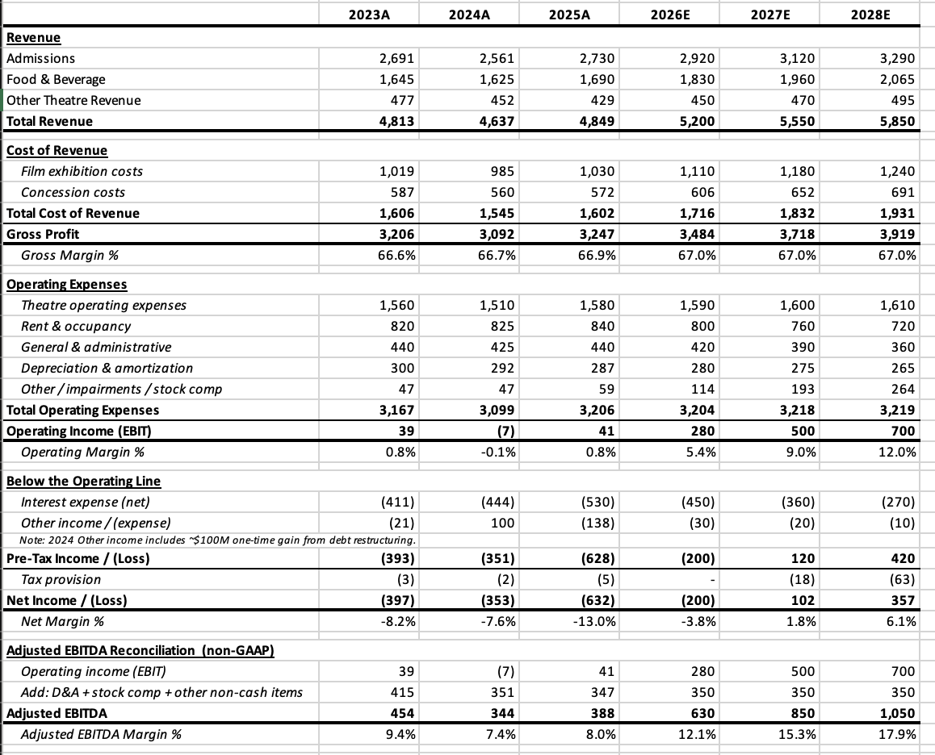
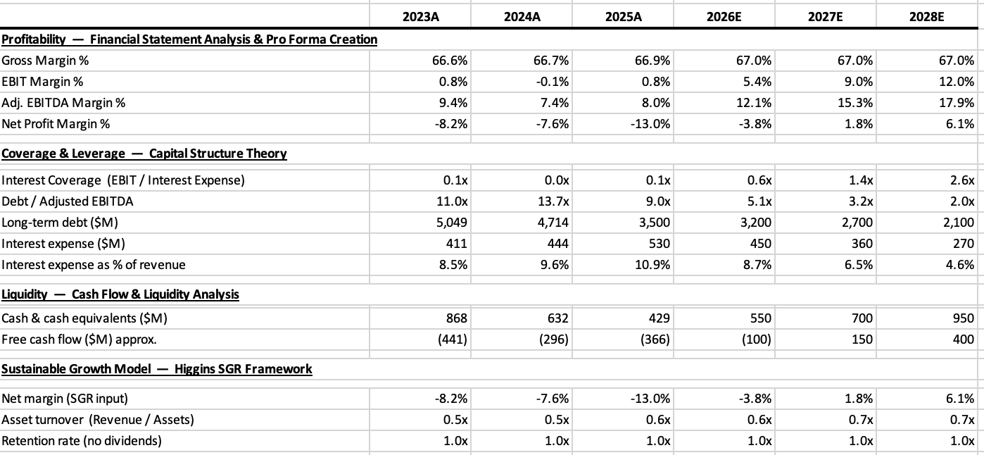
Pro Forma Financials: 2026–2028 Projection ($ in millions)
Ratio / Metric
2024A
2025A
2026E
2027E
2028E

Slide 7
🎬 Conclusion: A Coherent Plan Grounded in the Course Framework
How the Course Concepts Drove the Strategy
The 3-Year Milestones (2026–2028)
Financial Statement Analysis
2026
✓ Net loss narrows to $(200)M
Reading the IS revealed net losses are caused by interest, not weak operations. That one observation reframed the entire problem and pointed directly at debt restructuring as the solution.
✓ Coverage improves to 0.62x
YEAR 1
✓ Debt/EBITDA drops to 5.1x
Idea vs. Opportunity
✓ Revenue hits $5.2B (up 7.2%)
Confirmed AMC passes the market size, competitive advantage, and monetization tests — making this a real plan worth building, not wishful thinking.
2027
✓ First profit: $102M net income
Capital Structure + TVM
✓ Coverage crosses 1.0x (1.39x)
Optimal capital structure requires Debt/EBITDA below 3x. TVM proved paying down $2.3B in debt creates ~$2.3B in NPV of interest savings — the highest-ROI move available.
YEAR 2
✓ Debt/EBITDA drops to 3.2x
✓ Revenue $5.55B (+6.7%)
Cash Flow & Liquidity
Sized $400–600M of annual FCF for debt paydown, set a $500M liquidity floor, and connected premium F&B + subscriptions to improved working capital.
2028
✓ Net income $357M (6.1% margin)
Sustainable Growth Model
✓ Coverage at 2.59x — solid
YEAR 3
✓ Debt/EBITDA at 2.0x
Showed why equity dilution is destructive at current prices. Plan restores positive net margin in 2026 so growth is funded from earnings, not new shares.
✓ Balance sheet recovering

